Slide 1
Introduction To Python.
Presented By : IEEE CUSB
Biomedical Department
New Vision into Python !
By : Abdullah Gamal
Laila Hamdy

Slide 2
TABLE OF CONTENTS
01
03
02
04
What is Programming
Why Python ?
Mindset
Python Data types

Slide 3
TABLE OF CONTENTS
05
07
06
08
Conditionals
Functions
Loops
Data Structures

Slide 4

Programming
Programming is the implementation of logic to facilitate specified computing operations and functionality. It occurs in one or more languages, which differ by application, domain and programming model
-techopedia.com

Slide 5
01
Programming

Slide 6
How can we think about it ?
Programming is designing a set of instructions based on logical analysis of a problem to find a general solution for a specific program , The method in which we construct our solution is called our programming paradigm

Slide 7
General Programming Paradigms
Imperative
Procedural
OOP
Functional
It executes commands in a step-by-step manner, just like a series of verbal commands
It relies on procedures or subroutines to perform computations.
based on the concept of "objects", which may contain data, in the form of fields, often known as attributes; and code, in the form of procedures, often known as methods
It is the process of constructing programs by applying and composing pure functions, avoiding shared state, mutable data, and side effects.

Slide 8
—Linus Torvalds
““Talk is cheap. Show me the code.”

Slide 9
02
Mindset

Slide 10

Mindset
A programmer should be determined, patient, creative and willing to explore
Should take advantage of available resources found on the internet
Should be organized, systematic and have very sharp observation

Slide 11
03
Why Python ?

Slide 12
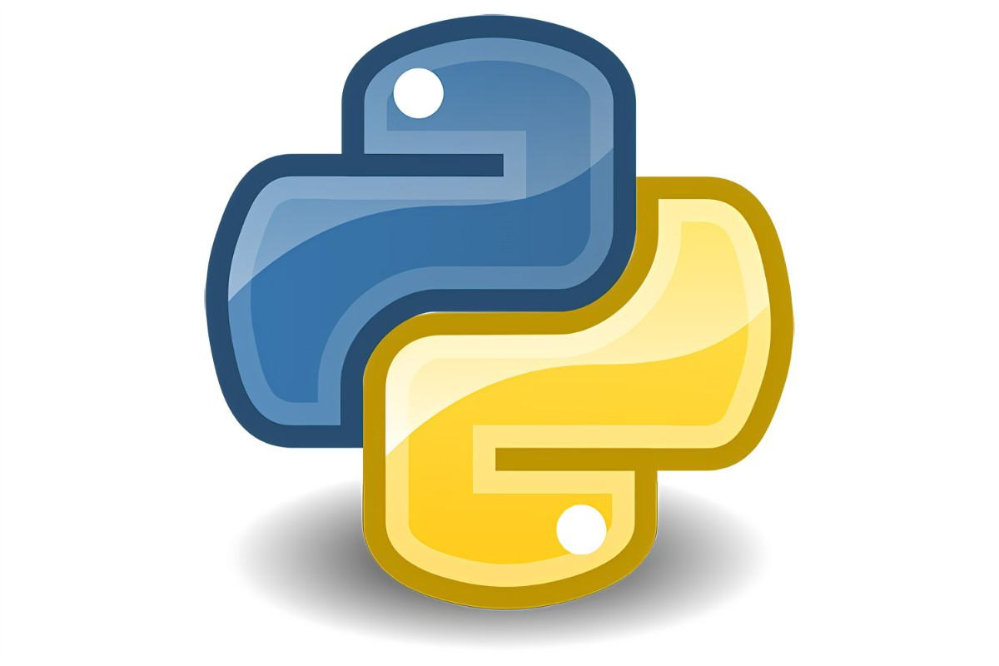
Python
Python is an interpreted language, commonly used for its versatility, ease to learn and use, support for several programming paradigms, and great community that can help to answer many questions

Slide 13
04
Data Types

Slide 14
What are Data types ?
Data types are the classification or categorization of data items. It represents the kind of value that tells what operations can be performed on a particular data. Since everything is an object in Python programming, data types are actually classes and variables are instance (object) of these classes
- GeeksforGeeks

Slide 15
Data Types
Numerical
Sequential
Boolean
set
Numerical Data types store number values, as int, float and complex numbers
Stores data in a sequence, as strings, lists and tuples
Stores a logical value, 0 or 1,
True or False
Stores an unordered collection of data type that is iterable, mutable and has no duplicate elements

Slide 16
05
Conditionals

Slide 17
What are Conditionals ?
conditionals provide a mechanism to control the flow of execution of a program in Python. In Python, the “if-statement” will run a section of code if and only if the conditional provided is true
- discovery.cs.illinois

Slide 18
06
Loops

Slide 19
What are Loops ?
Loops are used to perform a set of commands several times based on a condition
Python has two types of loops, they have different syntax but performs the same task

Slide 20
Python loops
The two python loops are for loops and while loops
The for loop is commonly used to iterate through a sequential data type or to repeat a block of code for a certain range of iterations
While loops iterates as long as the condition inside it is satisfied

Slide 21
Find the sum of first n numbers by for loop
n = input(“Enter the last number”)
sum = 0
for i in range(n):
sum += I
print(i)

Slide 22
Find sum of first n numbers by while loop
n = input(“Enter the last number”)
sum = 0
i = 0
while(i < n):
sum += i
i += 1
print(i)

Slide 23
Type of Loops
Loops are mainly divided into two types, Single loops consisting of only one loop, and nested loops which are made of two or more loops capsulated into each other

Slide 24
Single loops
Single loops are the easiest loop to understand, it is just repeating the same set of commands written inside the loop till a condition is satisfied

Slide 25
Nested Loops
Nested loops are a bit harder to understand but are quite easy once you see how it works
Every nested loops are divided into two parts, outer loop and inner loop
The outer loop is only incremented when the inner loop ends its cycle

Slide 26
Difference between single and nested loops
i = 5
j = 4
num_iter_single = 0
for x in range(i):
num_iter_single += 1
print(num_iter_single)
num_iter_nested = 0
for x in range(i):
for y in range(j):
num_iter_nested += 1
print(num_iter_nested)

Slide 27
07
Functions

Slide 28
Functions
Functions are divided into two types, predefined and user defined functions
They achieve code reusability, producing a clean code

Slide 29
Predefined functions
They are functions provided by the programming language to do essential operations generally needed in programming
To know how a function behaves write: help(function_name)

Slide 30
User defined functions
They are functions created by the programmer in order to divide the code into parts for easier handling and is considered a good coding practice

Slide 31
How to define your own function
def function_name([parameters]):
block of code
[return value(s)]

Slide 32
How to define your own function
def power(number,power):
answer = 1
i = 0
while(i < power):
answer *= number
i += 1
return answer
X = power(5,3)
print(X)

Slide 33
08
Data Structures

Slide 34
Data Structures
Data Structures are a way of organizing so that is can be accessed more efficiently depending upon the
Situation

Slide 35
Common Python Data Structures
Lists
Dictionaries
Python
Tuples
Sets
is an ordered collection of data, just like arrays in other languages
Are a key-value connected data structure
Data Structures
They are immutable lists
is an ordered collection of data that is mutable and does not allow any duplicate element

Slide 36
Indexing
Indexing is how we can access a specific object from an iterable data type as a list or a string
Python is a zero based indexing language

Slide 37


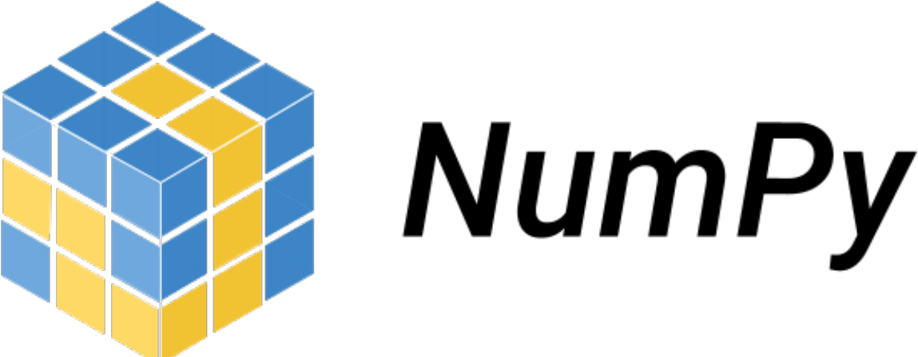
Popular libraries for Data Science
Numpy
Pandas
NumPy is a Python library used for working with arrays.
It also has functions for working in domain of linear algebra, fourier transform, and matrices.
Pandas is a Python library used for working with data sets.
It has functions for analyzing, cleaning, exploring, and manipulating data.

Slide 38



SOCIAL MEDIA
/IEEECUSB
/abdullahgamal19

Slide 39

ASSIGNMENT
What language is used to render 2D graphics in HTML5?
___

